Slide 1

Carbon dynamics: perspectives from ecosystem models
Sarah C. Davis
Interface Meeting, Captiva Island Fl
March 2, 2011

Slide 2
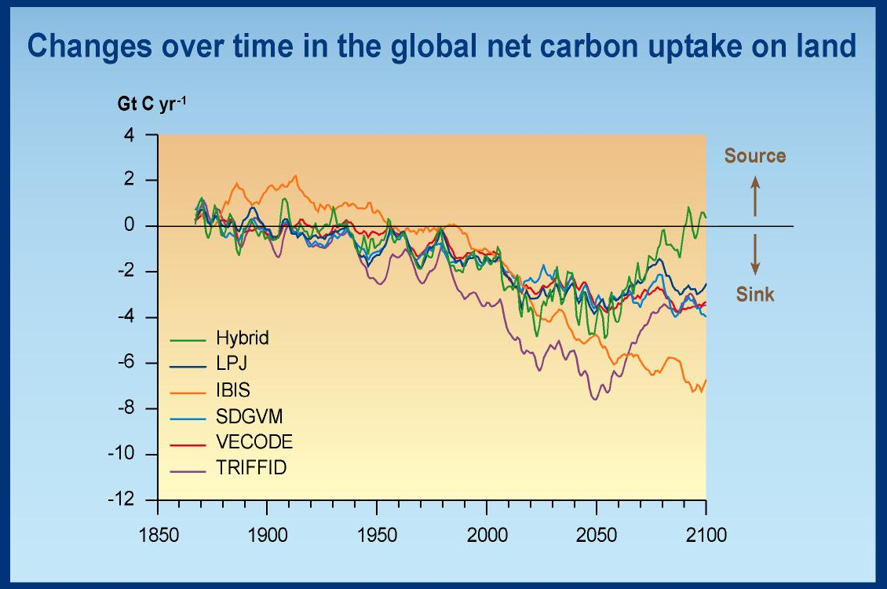
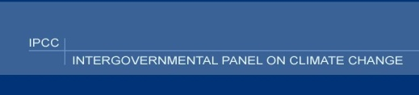

Slide 3
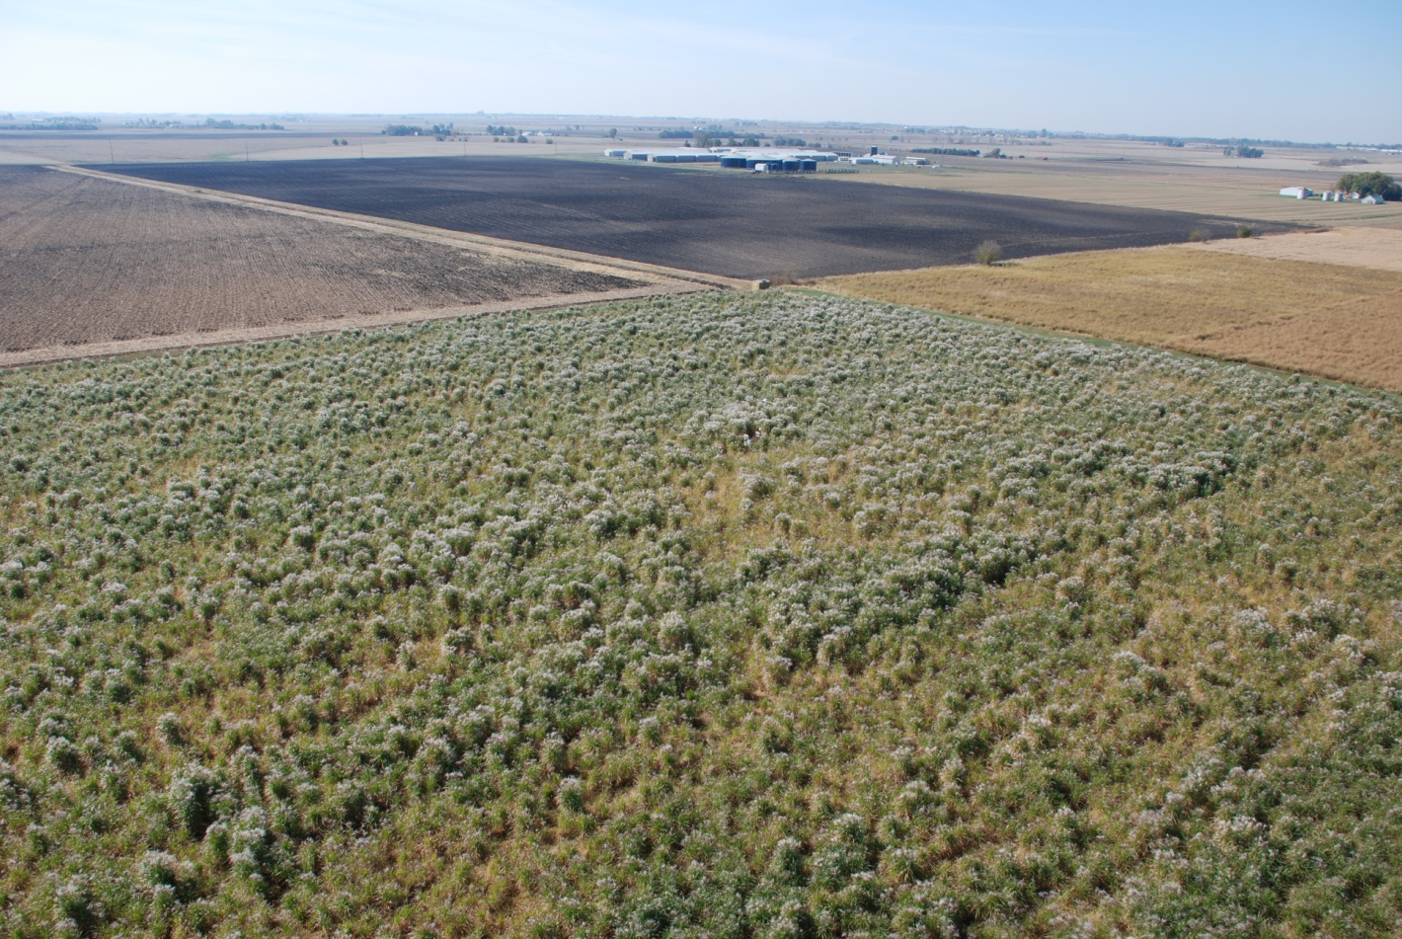
Major challenges
Long-term responses to climate change
Effects of land use change

Slide 4
Outline
Approach to modeling
Carbon trends in perennial grass crops
  – belowground carbon sequestration
Land use issues and challenges
Carbon dynamics in forested ecosystems
  aboveground carbon sequestration
Resolving long term responses of forests to climate change

Slide 5
Ecosystem modeling approach
Comparative ecosystem physiology
Comparative ecosystem biogeochemistry
Coupled to hypothesis-driven research

Slide 6
Example of a physiology-driven model
(PnET)
Maximum
gross
photosynthesis
Realized
gross
photosynthesis
GPP
VPD
PAR
daylength
Radiation
Net photosynthesis
Day temperature
Night temperature
Leaf nitrogen content
NPP
Basal
respiration
Realized
respiration
Notes:
Basal resp assumed 10% of photosynthesis

Slide 7
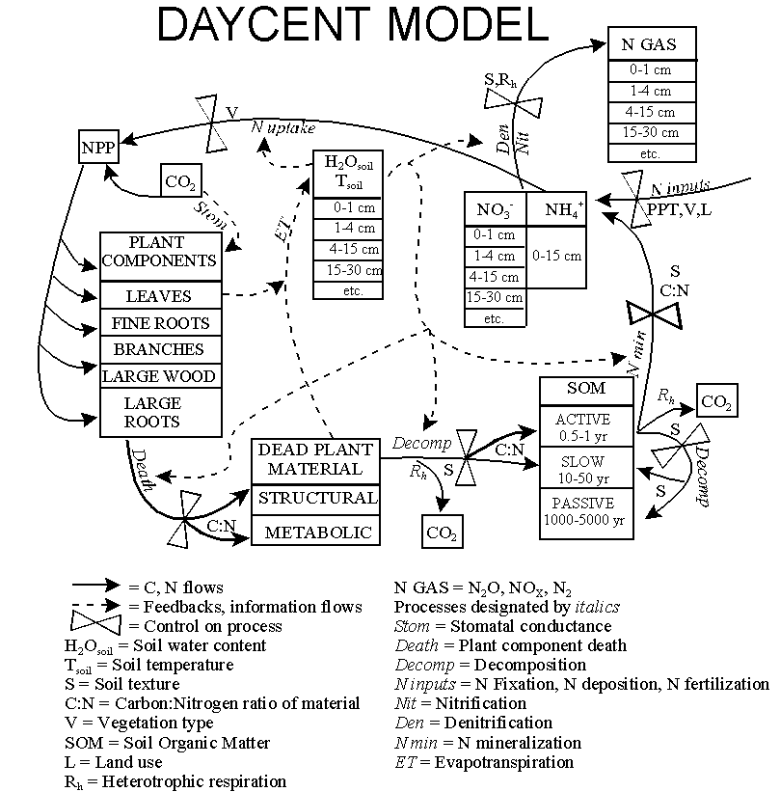
Example of biogeochemistry- driven model
Miscanthus x giganteus
Parton et al. 1998

Slide 8
Above- vs. Below-ground
Carbon Sinks
“Judicious management” can increase soil C
  Lugo et al., 1986, Cerri et al. 1991, Izaurralde et al. 2000, Conant et al. 2001, Zan et al. 2001, Lal 2004
Long-term carbon sequestration more dependent on increasing aboveground biomass
  Schlesinger 1990, Richter et al. 1999, Schlesinger and Lichter 2001

Slide 9
Ecosystem Models
Tools for characterizing effects of both climate change and land use change
Ecosystem productivity
Atmospheric CO₂
Ecosystem productivity
Atmospheric CO₂
Biomass Harvest

Slide 10
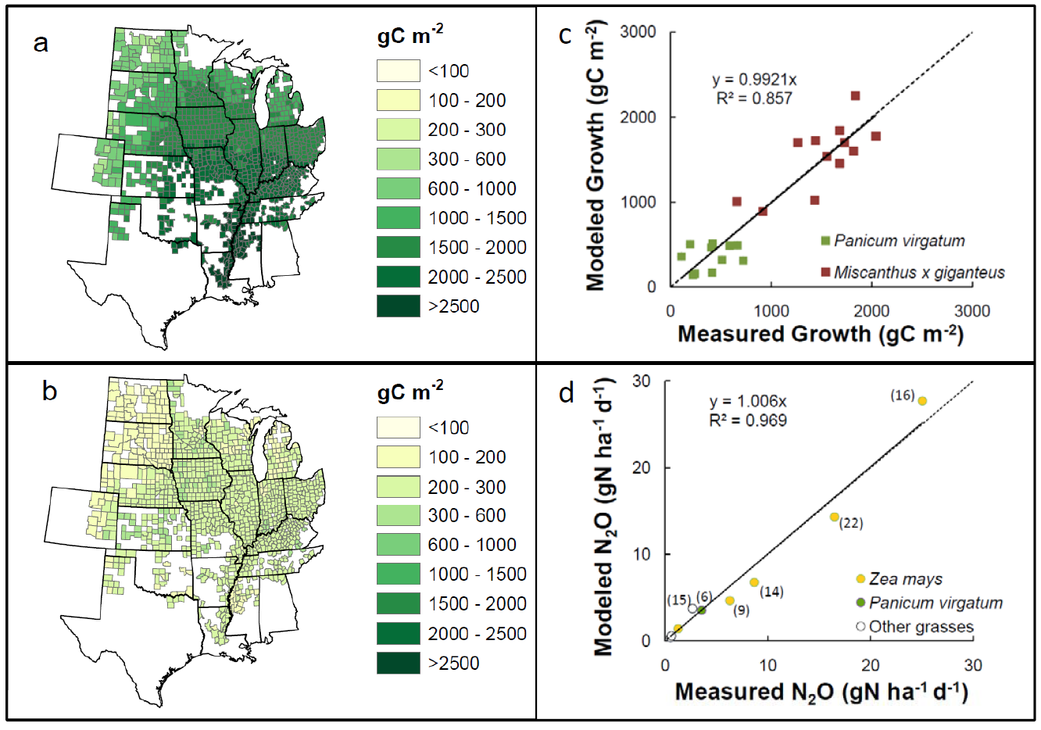
Miscanthus and Switchgrass
Davis , Parton et al. 2011 in press

Slide 11
Net Greenhouse Gas Fluxes
Corn
Miscanthus
Switchgrass
no fertilizer
Switchgrass
fertilizer
Davis , Parton et al. 2011 in press

Slide 12
Soil Carbon
Corn
Miscanthus
Switchgrass
no fertilizer
Switchgrass
fertilizer
Davis , Parton et al. 2011 in press

Slide 13
Land Use Change
A controversial issue for biofuels
Scaling beyond the case study is very difficult
Political forces are sometimes inhibitory
We need internationally standardized land use monitoring and databases
  See Davis et al. 2011 in
  Journal of the Royal Society Interface

Slide 14
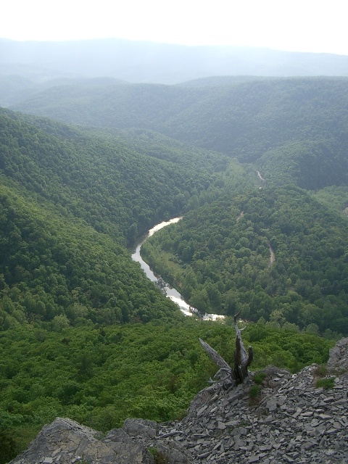
Eastern US Forest Carbon Sink
Regenerating forests
  Caspersen et al. 2000, Schimel et al. 2000, McGuire et al. 2001, Hurtt et al. 2002, Goodale et al. 2002, Houghton 2003, Nabuurs et al. 2003
Climate change
  Schimel 1995, Cao & Woodward 1998, Kicklighter et al. 1999, Joos et al. 2001, Joos et al. 2002, McGuire et al. 2001

Slide 15
Loblolly Pine Production

Slide 16
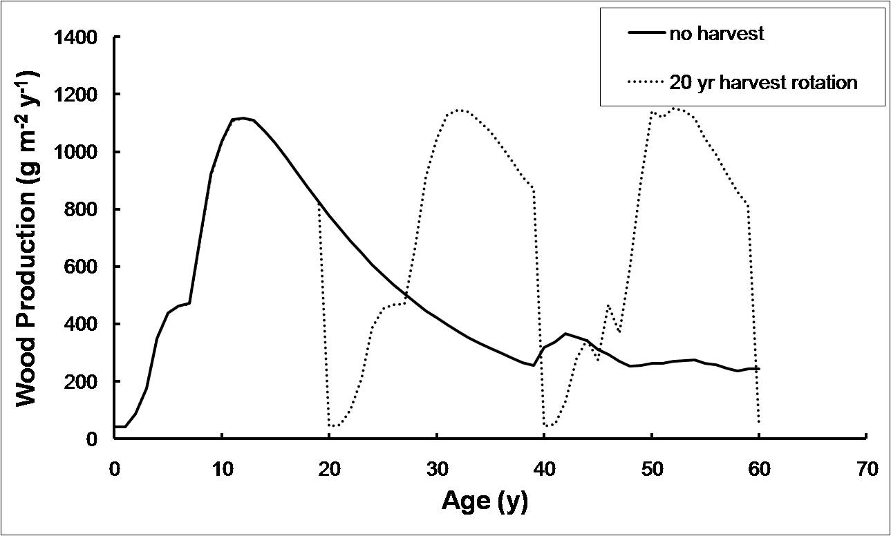
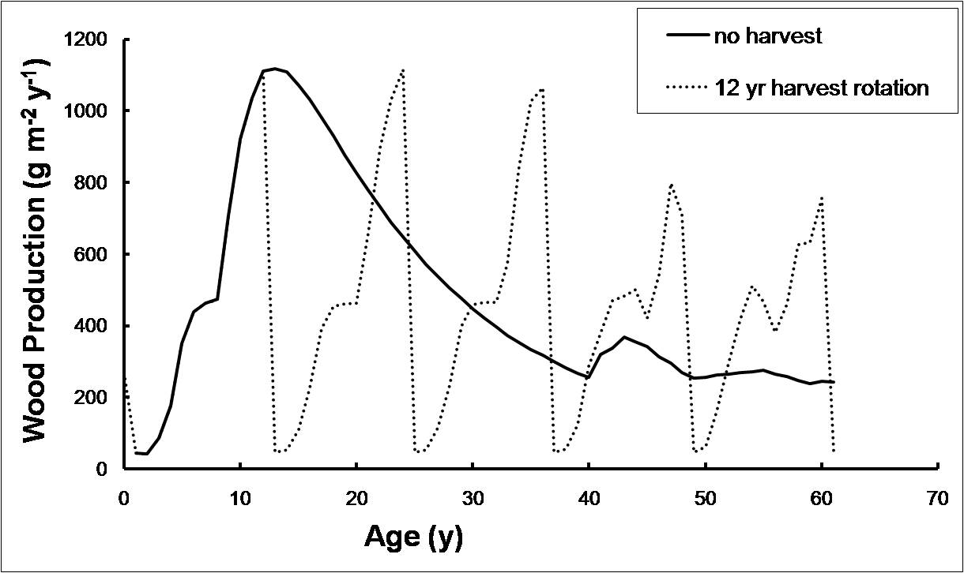
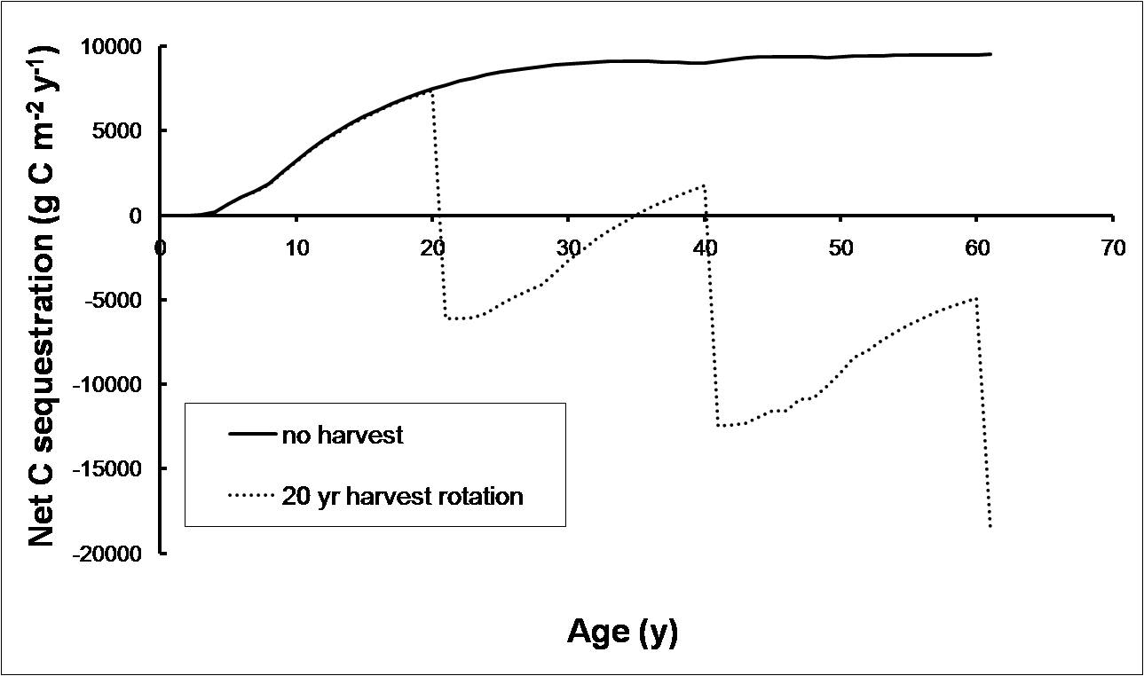
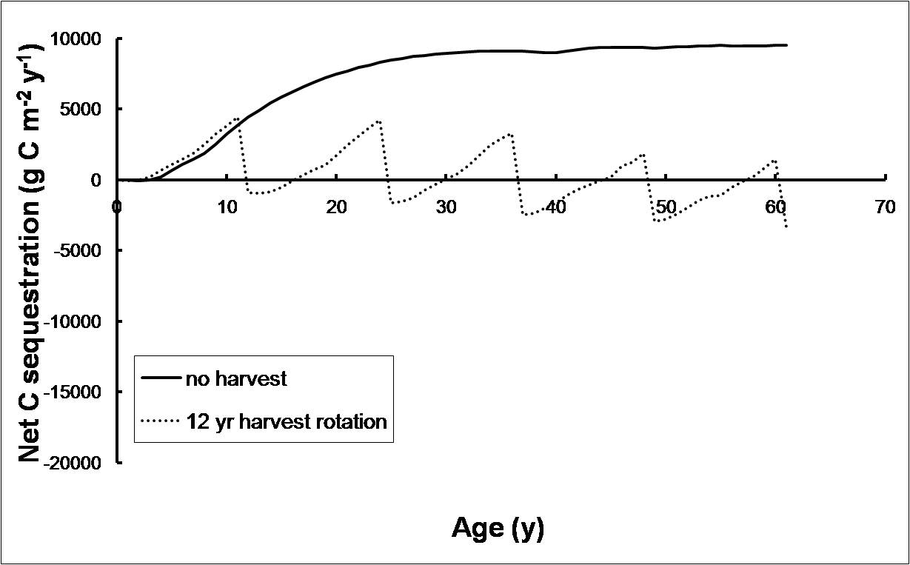
Pine Plantation Harvests

Slide 17
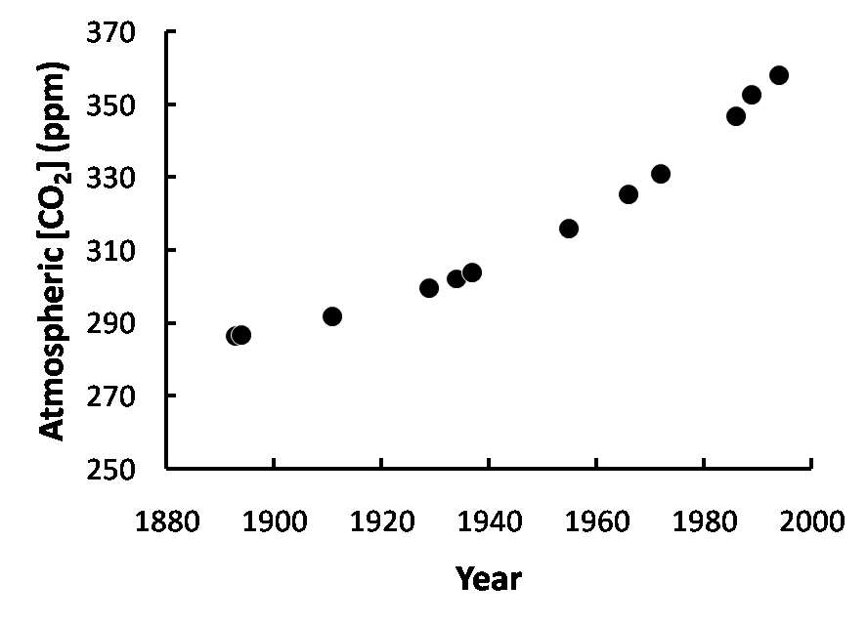
How do forested respond to climate change over time?

Slide 18
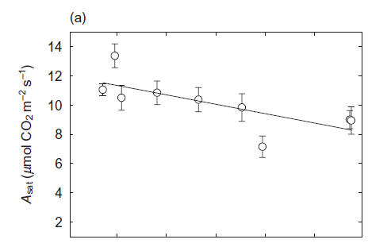
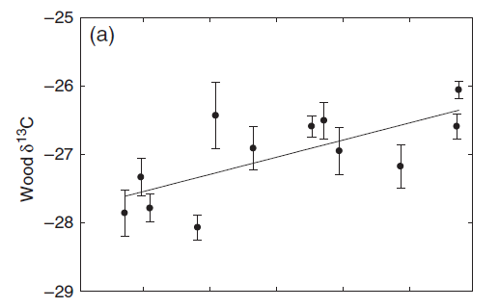
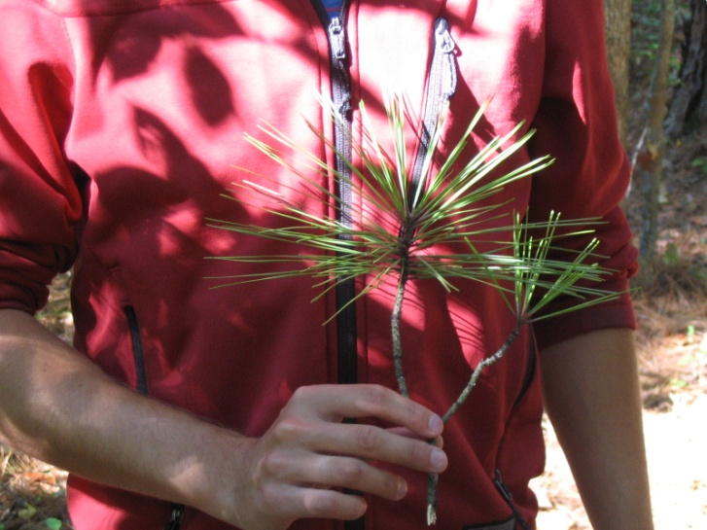
Loblolly pine production over time
Drake, Davis, Raetz, DeLucia
2010 Global Change Biology

Slide 19
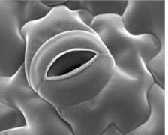
Photosynthetic Response to CO₂
C_{a}
= ¹²CO₂
+ ¹³CO₂
C_{i}
C_{i} :C_{a} is proportional to photosynthesis (A)
Lower C_{i}:C_{a} means more ¹³C is assimilated
Notes:
Stomata control the diffusion of gases between a forest canopy and the atmosphere.

Slide 20
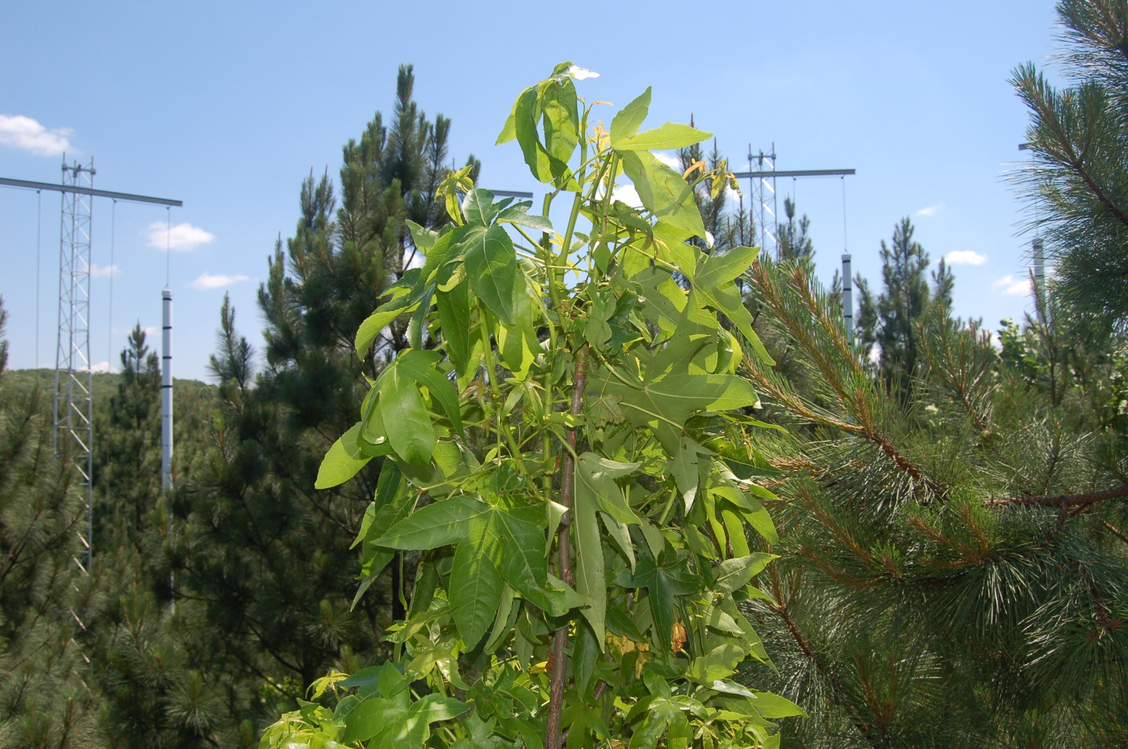
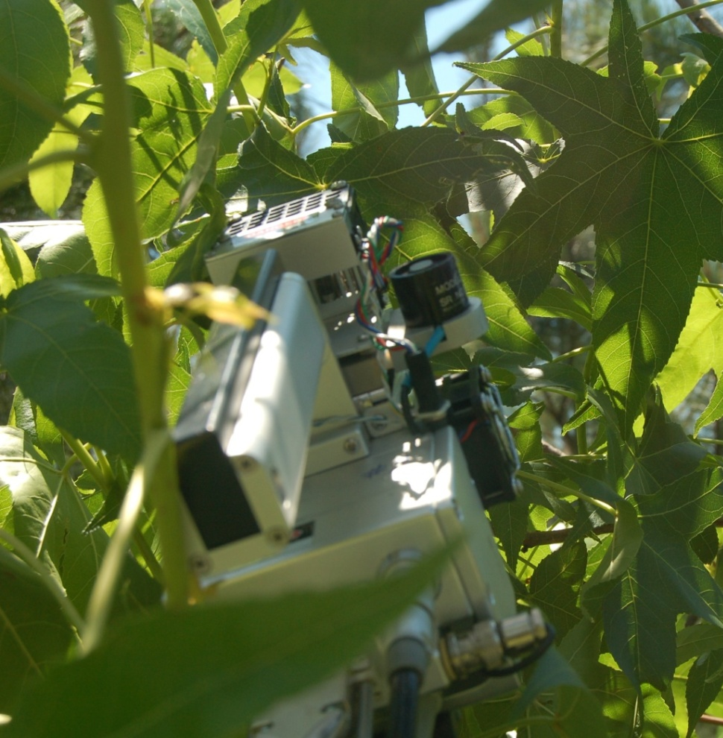

Slide 21
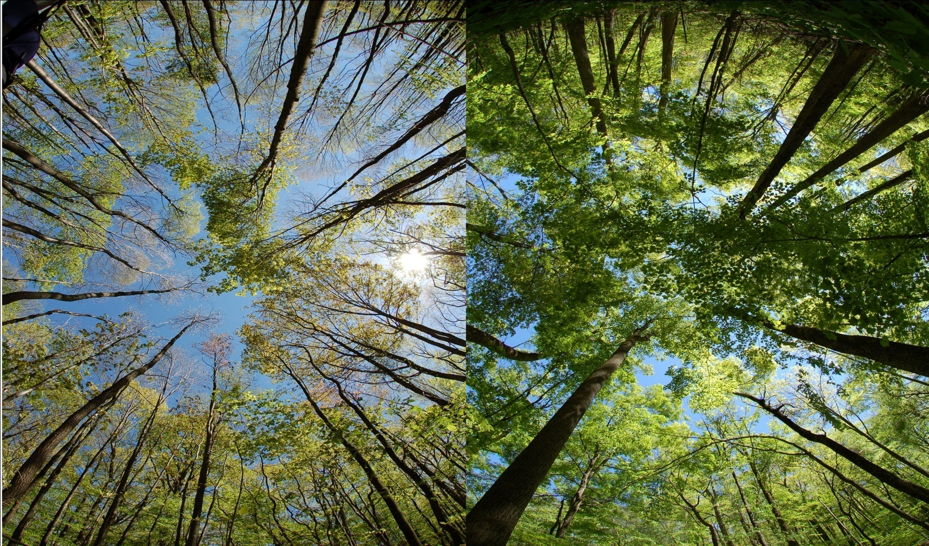
Do young and old forests respond similarly to climate change?

Slide 22
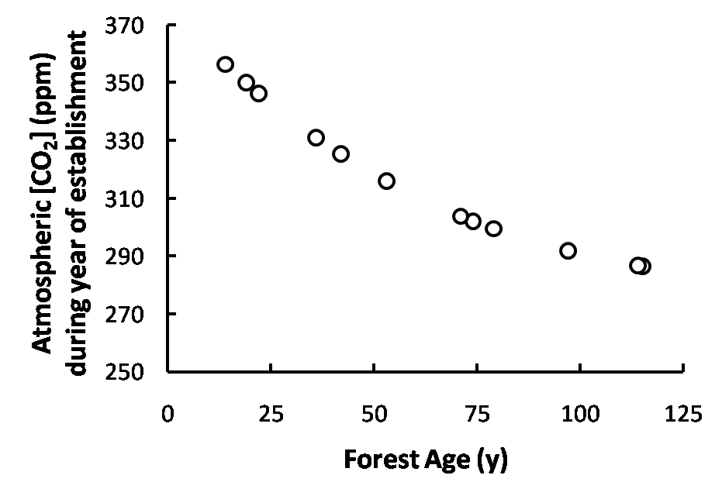
Old forests have experienced the changing atmospheric CO₂ concentration
Is the gradual response to CO₂ over a century similar to the instantaneous response?

Slide 23
Historical response vs. Projected Response

Slide 24
Physiological Constraints on Response to CO₂ vary over time

Slide 25
Summary
Soil carbon sequestration is greater in perennial crops than row crops.
There is a need for internationally standardized land use data.
Older forests may be more responsive to increases in atmospheric CO₂ than younger forests.

Slide 26

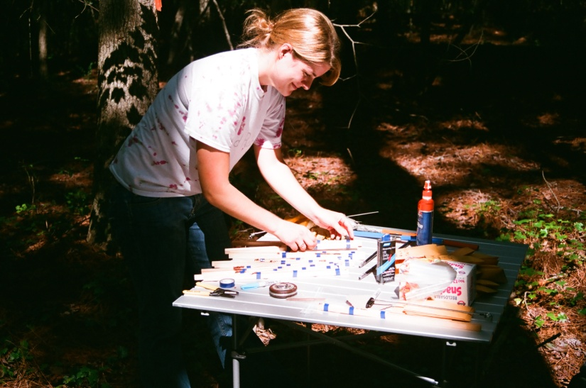
Acknowledgements
Steve Del Grosso
Evan DeLucia
John Drake
Cindy Keough
Ernest Marx
Tim Mies
Steve Long
Bill Parton
Lisa Raetz

Slide 27
